Slide 1
Data Preprocessing

Slide 2
Contents
What & why preprocessing?
Types of data
Identifying and handling missing values and outliers
Encoding for Categorical Data
Data normalization
Train and Test Data

Slide 3
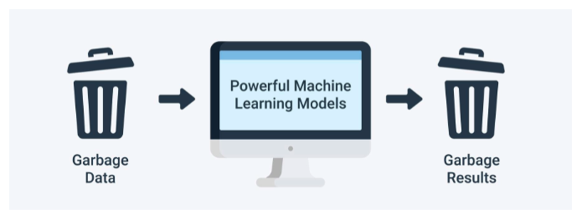
What & why preprocessing?
real-world data is incomplete, inconsistent, inaccurate (contains errors or outliers), and often lacks specific attribute values/trends.
some algorithms assume each input variable, and perhaps the target variable, to have a specific probability distribution.
Transforms data into understandable format
Notes:
Eg: linear machine learning models that expect each numeric input variable to have a Gaussian probability distribution.
Some algorithms are known to perform worse if there are input variables that are irrelevant or redundant to the target variable. There are also algorithms that are negatively impacted if two or more input variables are highly correlated
Incomplete : missing values eg: occupation= ‘’
Noisy : outliers eg: s;ary = -10
Inconsistent : age 42, bday : 03/07/2000

Slide 4
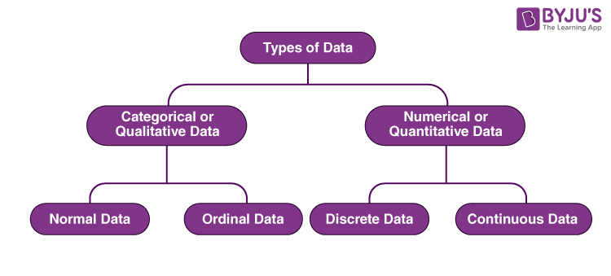
Types of data
Categorical Data
  Nominal Data : Hair color
  Ordinal Data: Ranking system
Numerical Data
  Discrete Data: Total numbers of students present in a class
  Continuous Data: Wi-Fi Frequency
Notes:
Ref : https://www.mygreatlearning.com/blog/types-of-data/

Slide 5
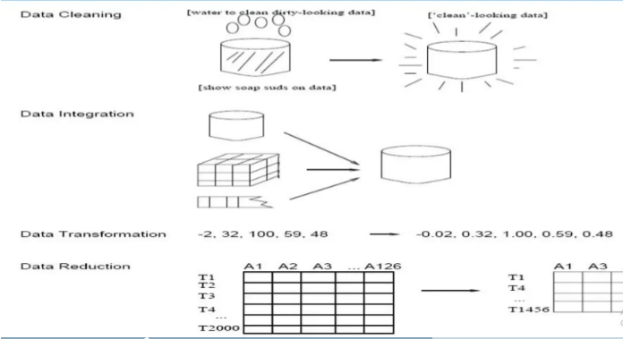
Data Preprocessing
Steps:
  Data Cleaning
  Data Integration
  Data Transformation
  Data Reduction

Slide 6
Data Preprocessing : Data cleaning
Task involves filling of missing values, smoothing or removing noisy data and outliers along with resolving inconsistencies.
Some reasons: dummy values, absence of data.
Methods for missing values: ignore data row, fill manually, mean or median, data mining algo to predict probable value
Handle noise and outliers by binning
Remove duplicate or irrelevant data
Notes:
Ref: https://towardsdatascience.com/data-preprocessing-e2b0bed4c7fb

Slide 7
Data Preprocessing : Data integration
Task involves integrating data from multiple sources such as databases (relational and non-relational), data cubes, files, etc.
  Removing duplicates and redundant data
  Schema integration
    Eg: A.custID. = B.customerId
  Data value conflict
    Weight in one system in Kg and other in grams

Slide 8
Data Preprocessing : Data Transformation
Tasks involves normalization and aggregation of data according to the needs of the data set
Normalization: scaled to fall within a small or specified range
  New attributes constructed from given ones
Aggregation
  Integrate data from different sources (tables)

Slide 9
Data Preprocessing : Data Reduction
The number of records or the number of attributes or dimensions can be reduced. Reduction is performed by keeping in mind that reduced data should produce the same results as original data.
Strategies
  Dimensionality reduction
  Sampling
  Remove redundant or closely associated ones

Slide 10
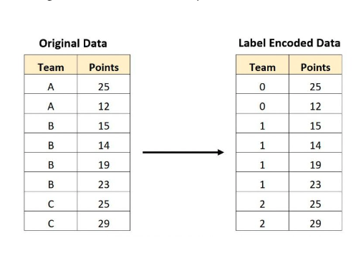
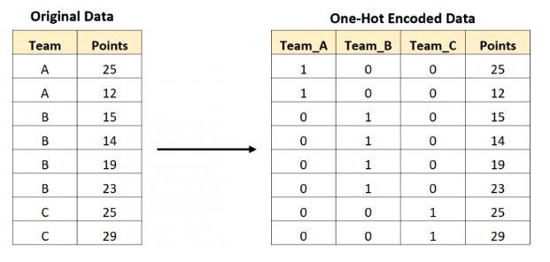
Encoding for Categorical Data
Types
  1.Label Encoding
    Assign each categorical value an integer value based on alphabetical order.
  2. One Hot Encoding:
    Create new variables that take on values 0 and 1 to represent the original categorical values.
Example ?

Slide 11
Data normalization
Data normalization transforms the multiscale data all to the same scale
Methods for Data Normalization
  Min-max normalization
  Decimal place normalization
  Z-Score Normalization
Notes:
https://analyticsindiamag.com/understanding-the-importance-of-data-cleaning-and-normalization/#:~:text=Data%20normalization%20is%20the%20method,to%20ensure%20logical%20data%20storage.

Slide 12

Reading Dataset
Pandas, Numpy, Matplotlib
Understanding dependent and independent variables
Slicing operations
Notes:
Use notebook

Slide 13
Train and Test Data Split explained

Slide 14
Jupyter notebook execution

